Slide 1
Transportation and Metering of fluids
By
Dr. S. S. Baral 20th Nov 2013

Slide 2
Outline
Pipe and tubing
Joints and fittings
Valves
Pumps
Introduction and basics
Positive displacement pumps
Centrifugal pumps
Compressors, Fans and Blowers

Slide 3
Pipes and tubing
Size (diameter), wall thickness and material of construction
Pipe (App 3)
Size
NPS/IPS
Regardless of wall thickness outside diameter of all pipe of a given nominal diameter is same.
Wall thickness
Schedule No (increases with thickness)
Material of construction
Metals (Low carbon steel), alloys, plastic, glass, ceramic, PVC, etc.)

Slide 4
Pipes and tubings
Tubes
Size
In terms of outside diameter
Wall thickness
BWG (Birmingham Wire Gauge) (decreases with thickness)

Slide 5
Joints and fittings
Flanges
Flanges with openinngs
Blind flange
Screwed fittings
Welded joint

Slide 6
Valves
Devices which control the amount and direction of fluid flow in piping systems
Typically made of bronze, brass, iron, or steel alloy
Components
Valve body
Packing
Disc
Packing gland/nut
Seat
Stem
Bonnet
Wheel

Slide 7
Valves - Types
Two basic groups
Stop/control valves
Used to stop or partially shut off the flow of a fluid
Examples : Gate, Globe, Needle, Plug, Butterfly valves
Check valves (NRVs)
Used to permit the flow only in one direction
Examples – Swing-check, Ball-check, etc.
Special types
Relief valves
Pressure reducing valves
Remote operated valves

Slide 8
Globe valve
Most common type of stop/control valve
Used in steam, air, water, & oil pipelines
Disc attached to valve stem rests against seat to shut off flow of fluid
Adv: Used for throttling/controlling the flow
Disadv: Large pressure drop (flow resistance )

Slide 9
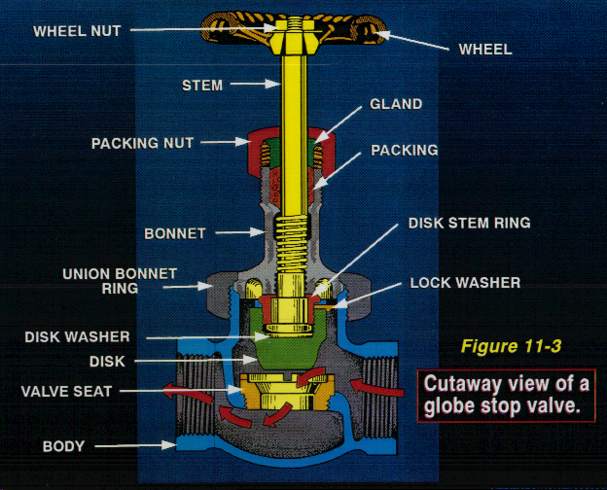
Globe valve

Slide 10
Gate valve
Used when there must be straight-line flow of fluid with minimum resistance
Gate usually wedge-shaped or a vertical disc
Adv: No flow restrictions
Disadv: Poor throttling

Slide 11
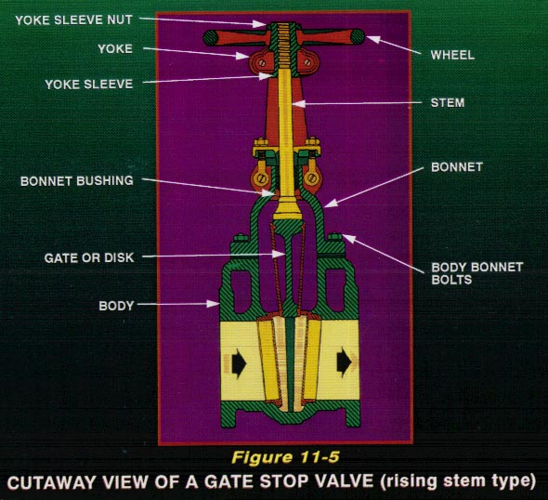
Gate valve

Slide 12
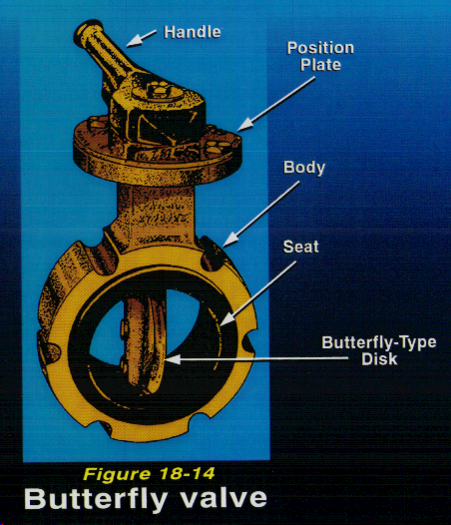
Butterfly valve
Used in water, fuel, and ventilation systems
Adv: small, light-weight, & quick-acting
Disadv: leaks early & only low-flow throttle

Slide 13
Ball valve
Similar to butterfly valves
Normally found in seawater, sanitary, trim and drain, and hydraulic systems
Have applications in controlling the flow

Slide 14
Check valve
Controls direction of flow
Operated by flow (pressure) of fluid in pipe
Types:
Swing check - disc moves through an arc
Lift check - disc moves up and down
Ball check - ball is located at end of stem and lifts to allow flow

Slide 15
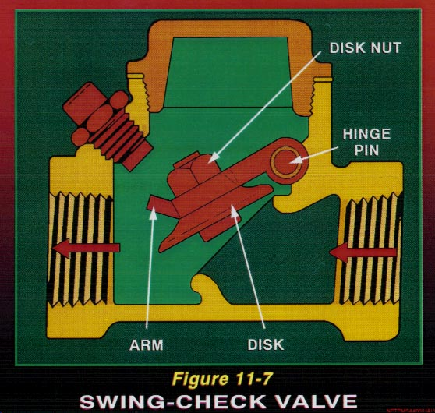
Check valve

Slide 16
Pumps
Device that uses an external power source to apply force to a fluid in order to move it from one place to another (increase its mechanical energy → Bernoulli’s eq)
Must overcome:
frictional forces from large quantities of fluid
difference in static pressure between two locations
Must provide any velocity desired

Slide 17
Cavitation
Cavitation
Phenomena that can occur in any machine handling liquid, when local static pressure falls below the vapor pressure of that liquid
Liquid can flash to vapor forming a vapor cavity in the system (machine)
Can alter local pressure field, creating unsteadiness that can cause vibration of the machine
Affects performance of the pump.
Must be avoided to maintain stable and efficient operation of the pump

Slide 18
Net Positive Suction Head
(NPSH)
To avoid cavitation, the pressure at the pump inlet must exceed the vapor pressure by a certain value, called NPSH.
Larger the NPSH, less likely the cavitation is to occur
NPSHR
NPSHA

Slide 19
Components (Construction)
Drive mechanism (steam, electric)
Pump shaft
Impeller or piston
Casing

Slide 20
Types of pumps
Positive displacement pumps
Fixed volume of fluid is displaced during each cycle regardless of static head/pressure pumping against
Types
Reciprocating pumps (Piston, Plunger, Diaphragm pumps)
Rotary pumps (Gear, Lobe, Screw pumps)
Centrifugal pumps
Mechanical energy is increased by centrifugal action
Volume of fluid is dependent on static head/pressure

Slide 21
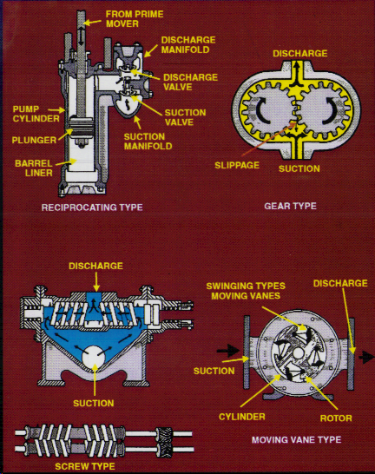
Positive displacement pumps

Slide 22
PD Pumps - Reciprocating
Piston pumps

Slide 23
PD Pumps - Reciprocating
Diaphragm pumps

Slide 24
PD pumps - Rotary
Gear pump

Slide 25
PD pumps
Mechanical efficiency
Ratio of power given to the fluid to the power (external) supplied to the pump
Volumetric efficiency
Volume of the fluid discharged to the volume swept by the piston or plunger

Slide 26
Centrifugal pumps
Most commonly used pump
Impeller inside a case (called volute)
Impeller is a disc with curved vanes mounted radially (like a paddle wheel)
Suction is the Eye -> fluid accelerated as it travels outward & then enters volute

Slide 27
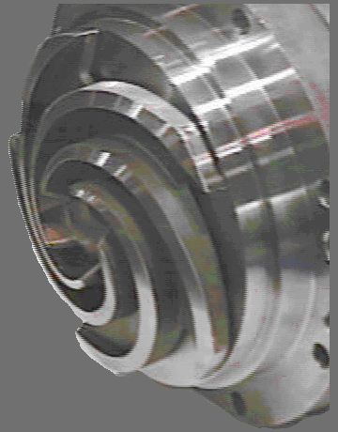
Centrifugal pumps - Impeller

Slide 28
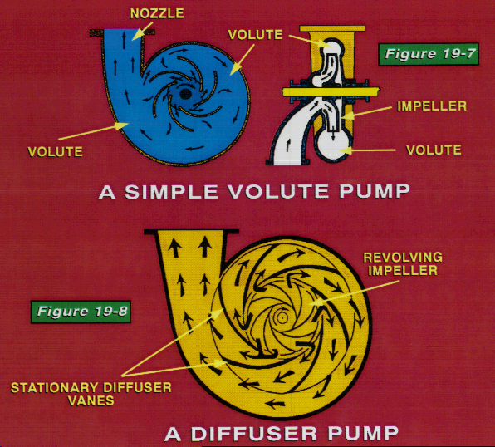
Centrifugal pumps

Slide 29
Centrifugal pumps
Parameters
N = pump speed, RPM
Q = volumetric flow rate,(m³/s, LPM)
H_{p} = pump head (discharge pressure)
P = power required (W)
P_{f} = Power supplied to the fluid (W)
η = Mechanical efficiency of the pump (P_{f}/P)
Affinity laws (Centrifugal pump laws)
Q α N
H_{p} α N²
P α N³

Slide 30
System curve
System curve
In most cases the total head of a system is a combination of static head and friction head as shown in the figure
System
curve
System head
Friction
head
Static head
Flow

Slide 31
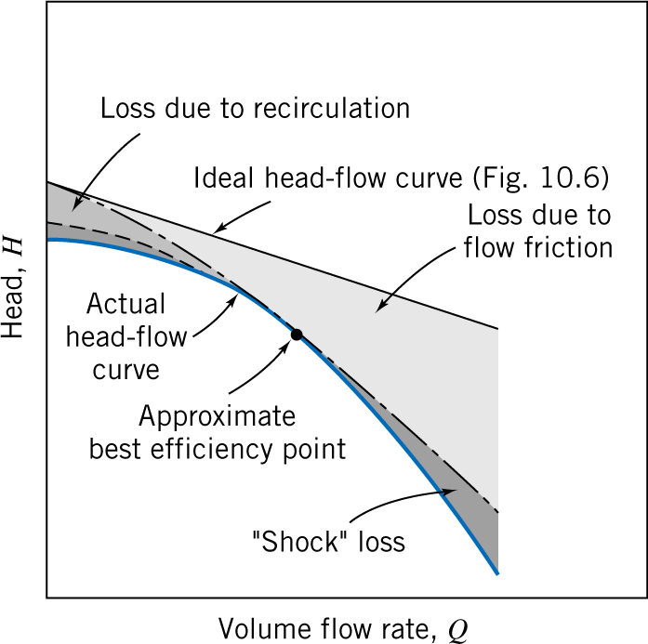
Pump performance (characteristic) curves
Head (H_{p} vs flow rate (discharge), Q)
Power vs flow rate
Efficiency vs flow rate

Slide 32
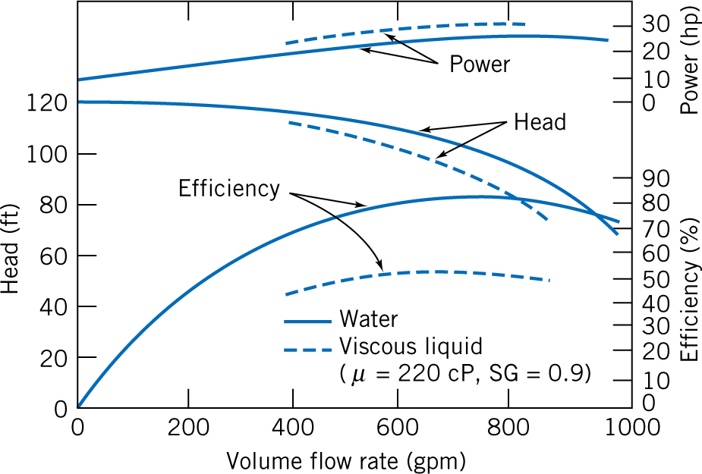
Pump Performance (Characteristic) curves

Slide 33
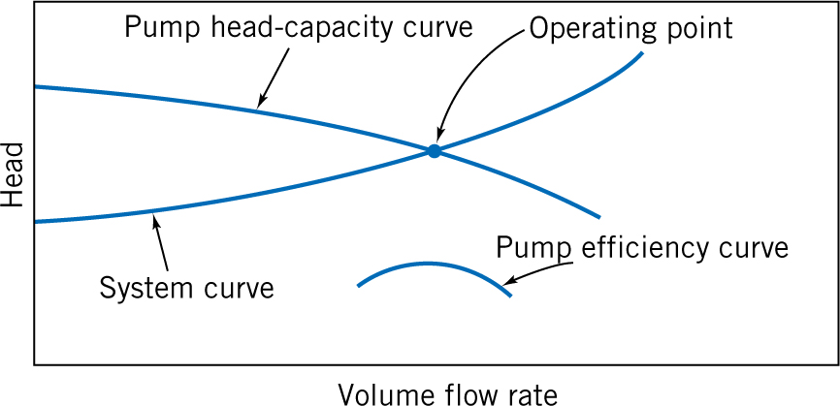
Pump Characteristic curves - Operating point
Maximum efficiency point

Slide 34
Centrifugal pumps
Pumps in parallel
Pumps in series

